Slide 1
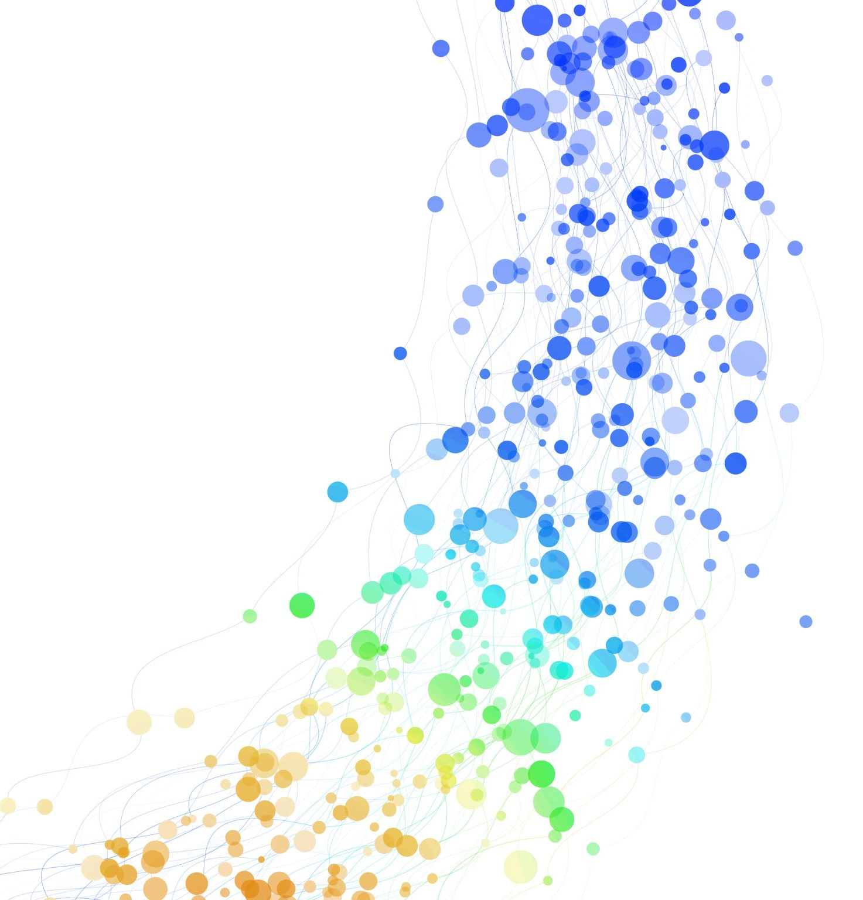
Python: Data Analysis Essentials
Instructor: Elena Fernández Fernández

Slide 2
Course Content
General Introduction
Course Introduction: Learning Data Analytics with Digital Humanities Metadata!
Introduction to Programming: Python Programming Language
Introduction to Jupyter Notebooks
Python Basics:
Data types: string, integer, float, boolean, null.
Variables
Data Structures: list, tuple, dictionaries.
Functions and (list) Methods.
Python Libraries
Numpy
Pandas
Seaborn

Slide 3

Day 1. Python review
1. General Introduction: Instructor Introduction, Students Introduction.
2. Course Introduction: Learning Data Analytics with Digital Humanities Metadata!
3. Introduction to Programming: Python Programming Language
4. Introduction to Jupyter Notebooks
5. Python Basics:
Data types: string, integer, float, boolean, null.
Variables
Data Structures: list, tuple, dictionaries.
Functions and (list) Methods.

Slide 4
1. General Introduction
About me
Education
B.A. English Philology, University of Salamanca, Spain (2006-2011).
M.A. Spanish Studies, University of Virginia, USA (2011-2013).
PhD Hispanic Languages and Literatures, University of California, Berkeley (2013-2019).
Work Experience
Data Science Post-doctoral researcher, Technical University of Munich (2019-2021).
Data Science Post-doctoral researcher, Institute of Computational Linguistics, UZH (2021-2023).
Lecturer, IT Zentrale Informatik, University of Zurich (2023-).
Areas of Research
Digital Humanities
Computational Social Science
Media and Communication Studies.

Slide 5
…and what about you?
PLEASE INTRODUCE YOURSELF! ☺

Slide 6

2. Course Introduction
Learning Objectives:
Understand basic concepts of the Python Programming Language (data types, data structures, functions, methods).
Learn how to use the essential Python libraries (NumPy and Pandas) for preparing, cleaning, transforming and aggregating your data for analysis.
Learn how to visualize different datasets using Seaborn.

Slide 7
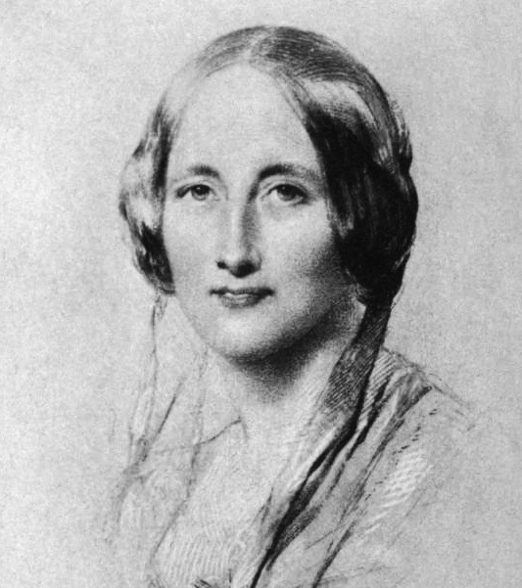
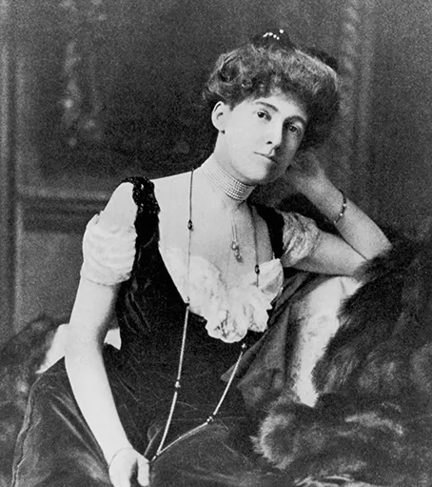
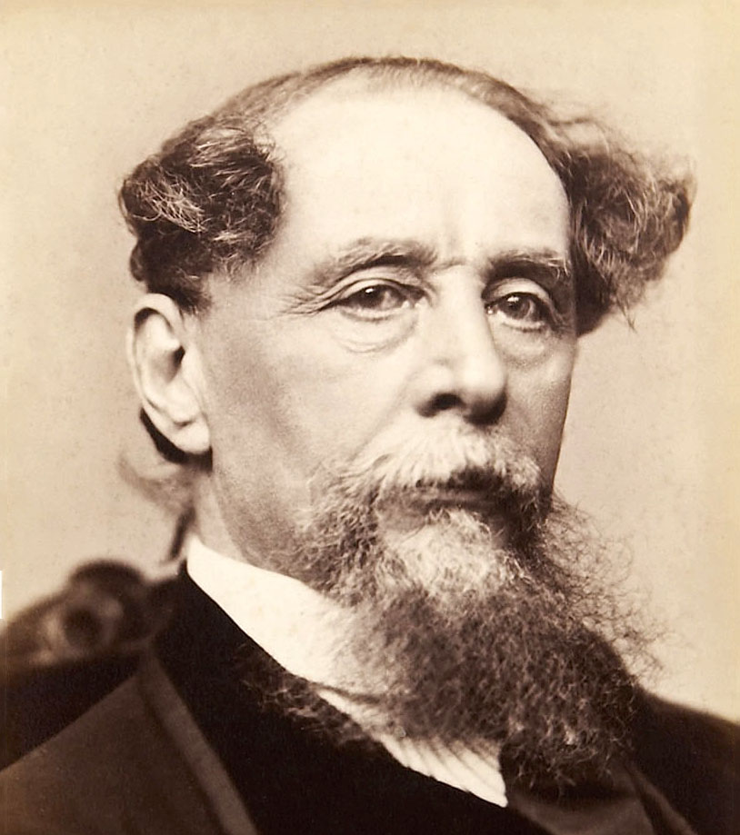
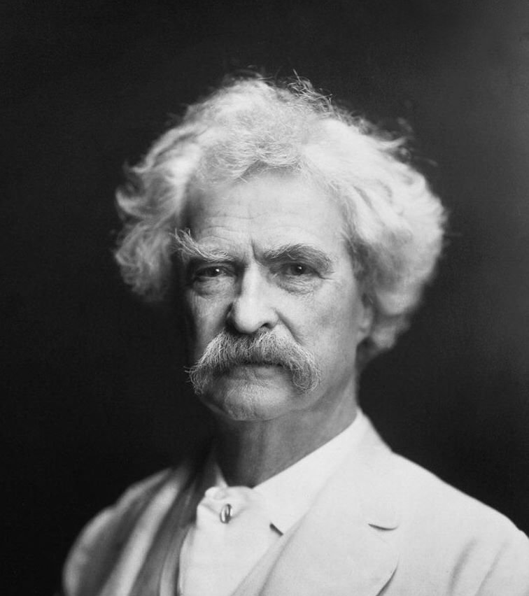
Digital Humanities Dataset
We are going to use a 19th century Anglo-Speaking dataset of “Social Realism” novels using four authors:
Two female authors: Elizabeth Gaskell (1810-1865) and Edith Wharton (1862-1937)
Two male authors: Charles Dickens (1812-1870) and Mark Twain (1835-1910)
Dickens and Gaskell are British and Twain and Wharton are from the USA.

Slide 8
Research question
Can we find any patterns in terms of gender (i.e. female vs. male authors) or country (UK vs. USA)?
We will use Numpy, Pandas, and Seaborn to answer those questions!

Slide 9
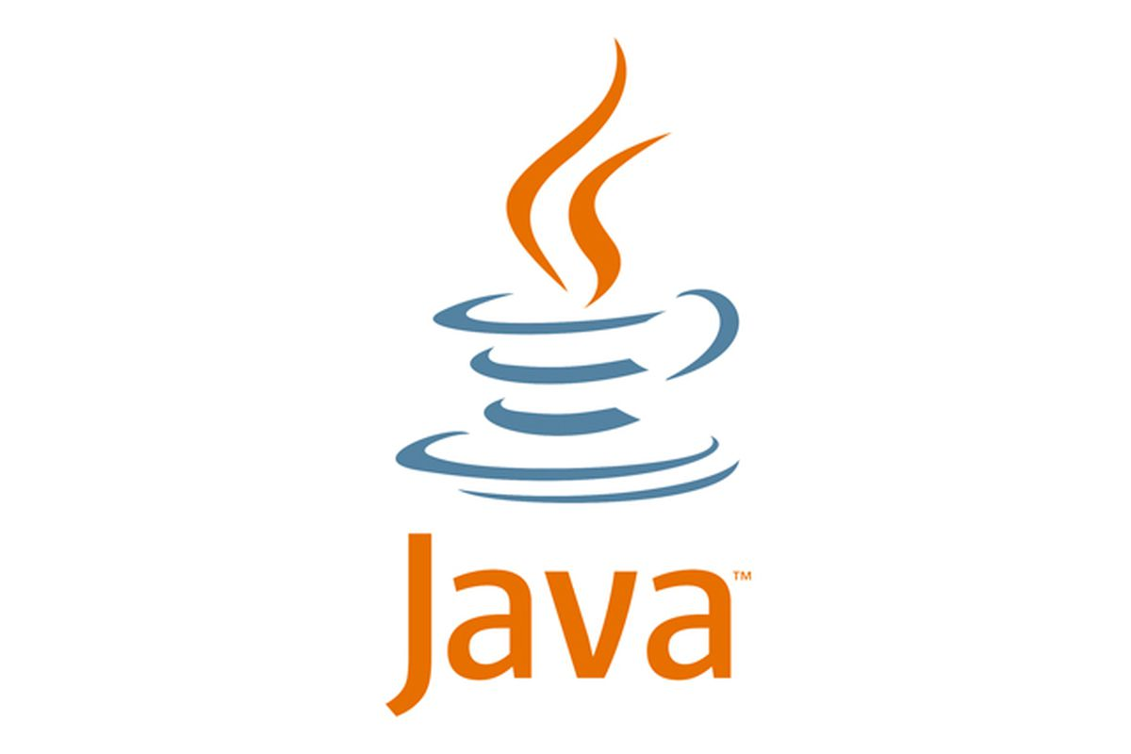
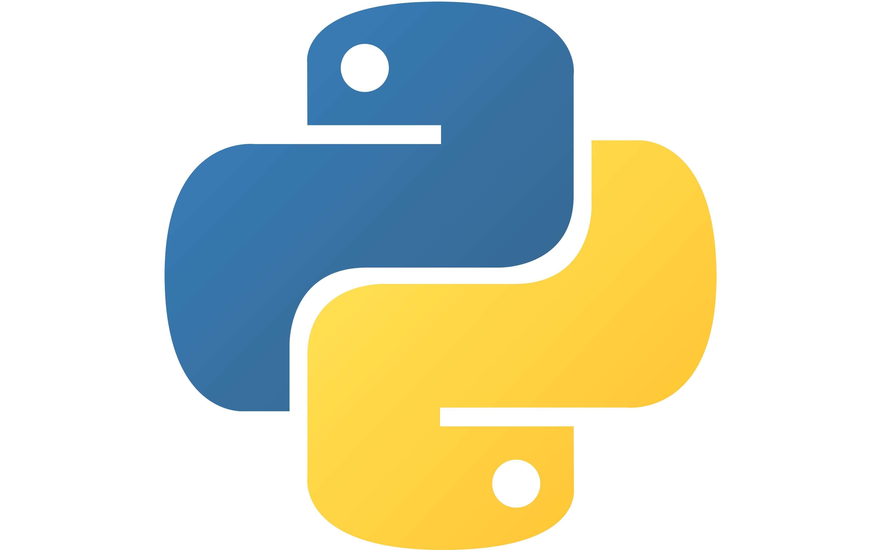

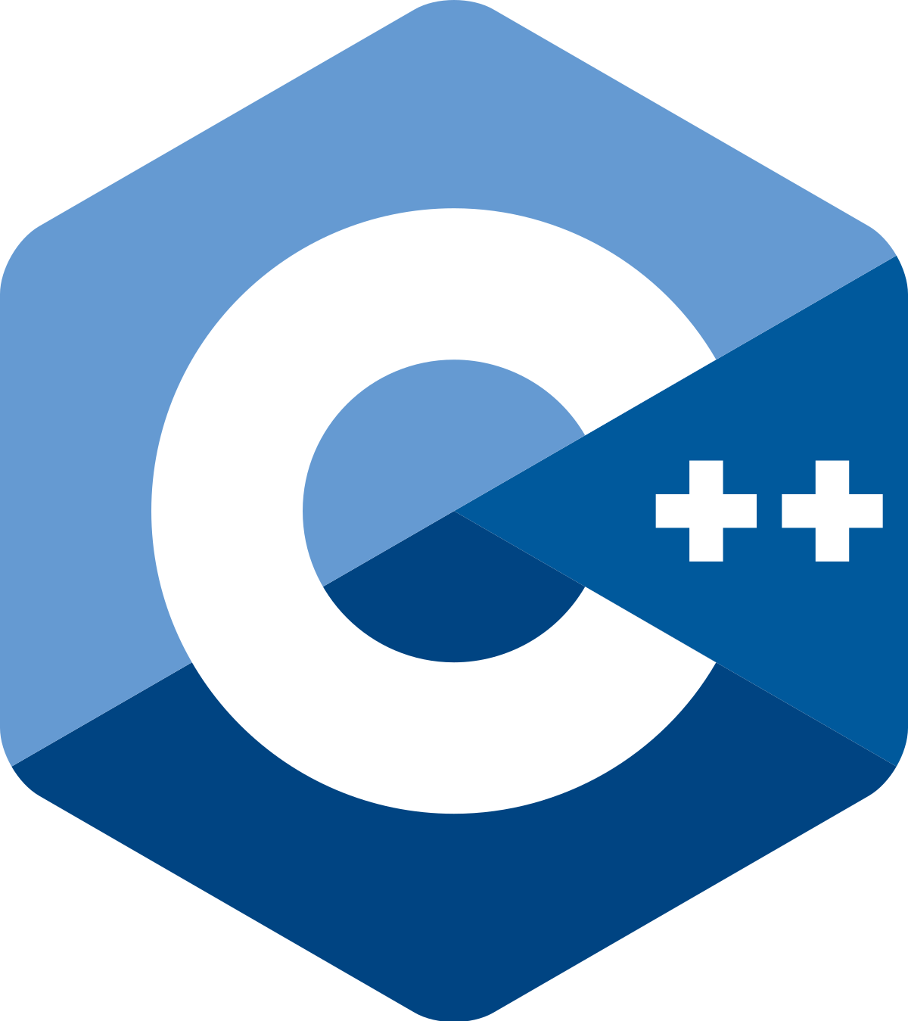
3. Introduction to Programming: Python Programming Language
…but first let’s learn the basics of Python!
What are programming languages?
The way in which we can communicate with computers. That is why they are called “languages”. In the same way that there are many languages in the world…
Hallo! Hello! Hola! Bonjour! Ciao! Obrigada!
…there are also many programming languages!

Slide 10
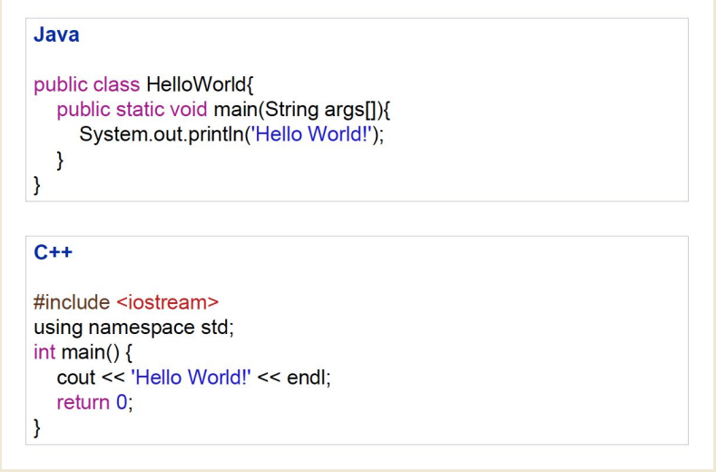
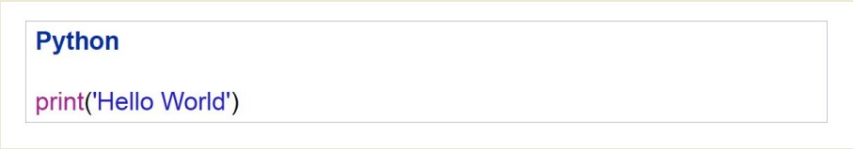
Programming languages also have syntax
These three examples are “communicating” the same thing. Which one is the simplest?

Slide 11
Why Python?
Simple syntax
Cross-platform (Jupyter Notebooks, Spyder, Pycharm…).
Many libraries available (nltk, pandas, numpy…).

Slide 12
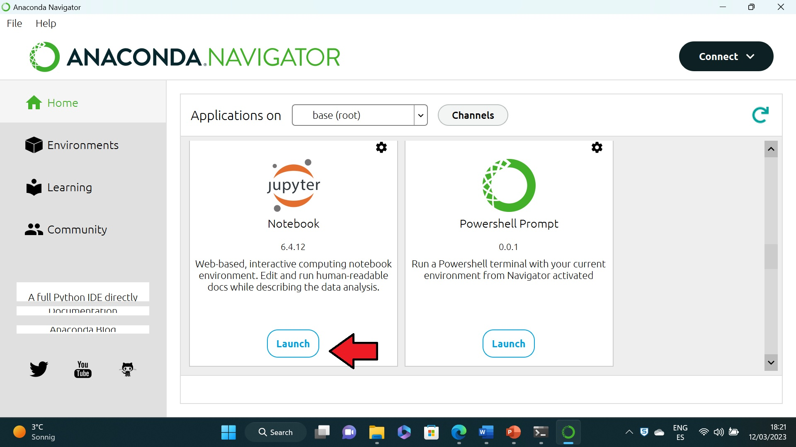
4. Introduction to Jupyter Notebooks
Python Interpreters: they make sure that code is written correctly (syntax check).
Then compile Python code and executes the code as well.
We will use the Python Interpreter “Jupyter Notebooks”.

Slide 13
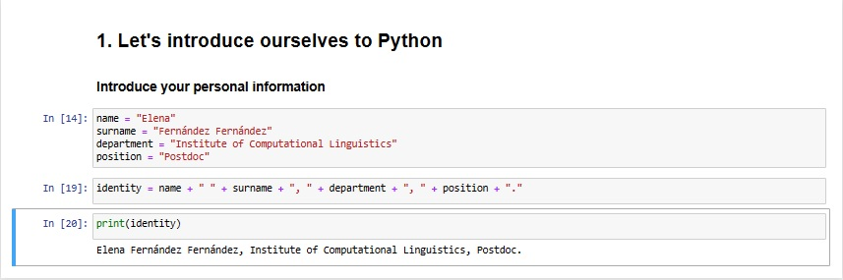
Let’s do a test on writing a script
Live Coding

Slide 14
5. Python Basics: Data Types
2
Integers 10,000
-5 “Hello World”
NUMBERS TEXT (Strings) ‘Hello World’
1.3 “5”
Floats 3.222222
4.5

Slide 15
Boolean None Type
Binary data type None is a special type (in other languages also sometimes called
* True null or nullptr). Sometimes it is necessary to indicate that
* False something is not there and this can be indicated by using None

Slide 16
Question for the class
Which data type?
Input | Data type?
“Good Morning” | ?
25 | ?
3.4 | ?
True | ?

Slide 17

5. Python Basics: Variables
Live coding
Variables are used to store information to be referenced and manipulated in a computer program. They also provide a way of labeling data with a descriptive name, so our programs can be understood more clearly by the reader and ourselves. It is helpful to think of variables as containers that hold information. Their sole purpose is to label and store data in memory. This data can then be used throughout your program.
Variables hold values
x = 2
y = x + 2
Values are assigned using the = operator
Day 1 Activity 1

Slide 18
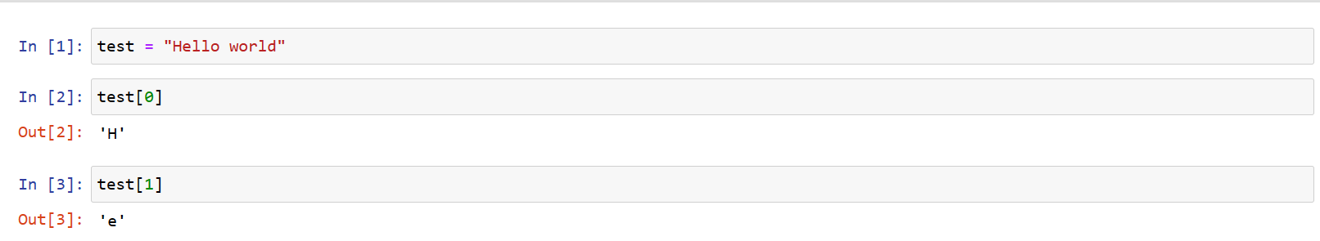
5. Python Basics: Data Structures.
PYTHON 0 INDEXING
Python is a programming language where the first element in a data structure (for example: a list or a string) is always 0. This can get a little bit confusing:
H | e | l | l | o |  | w | o | r | l | d
0 | 1 | 2 | 3 | 4 | 5 | 6 | 7 | 8 | 9 | 10

Slide 19
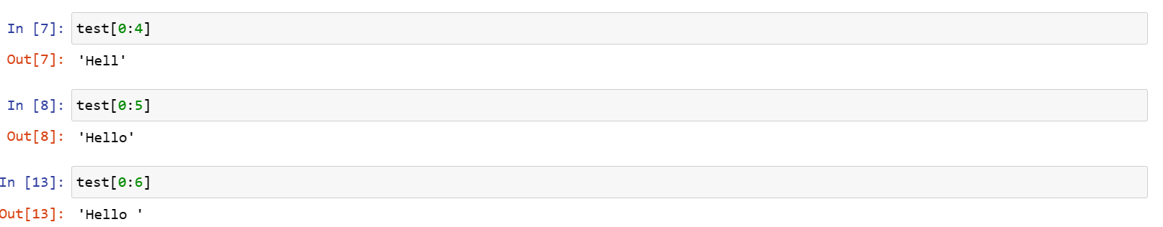
Live coding
Moreover, to select the last element in a list, we always need to write one extra number. Very confusing!

Slide 20

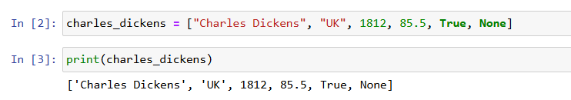
5. Python Basics. Data Structures. Lists[]
Lists are a data structure and are used in most programming languages (arrays)
Lists are a set of values
The easiest way to create them is using []
Initialization of a list (a list can contain different data types!)

Slide 21

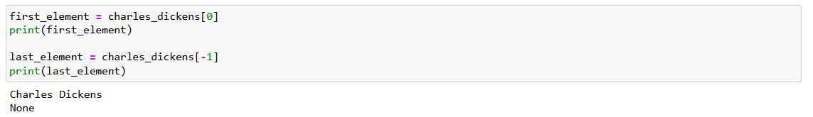
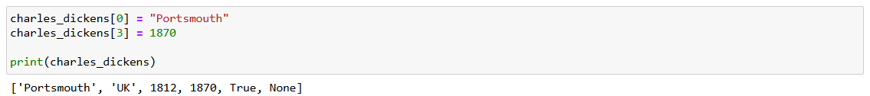
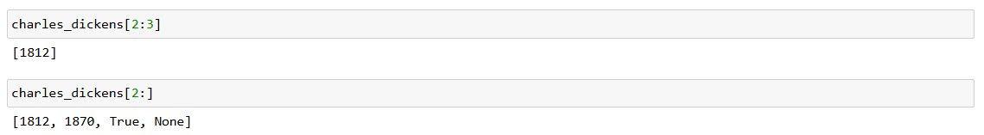
Accesing elements
Changing values
Slicing

Slide 22
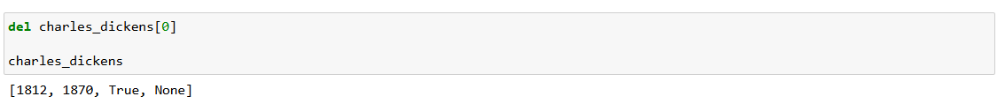
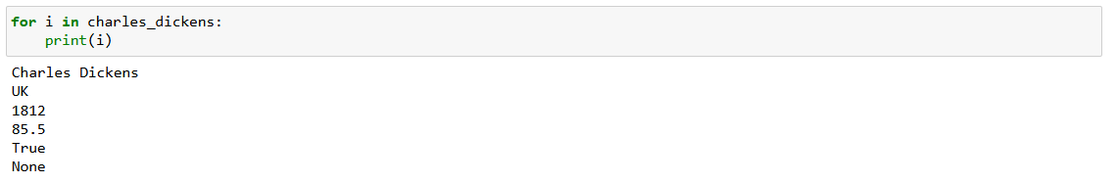
Removing Elements
Iterating over a list elements
Check if a value exists in a list
Check if a value exists in a list

Slide 23
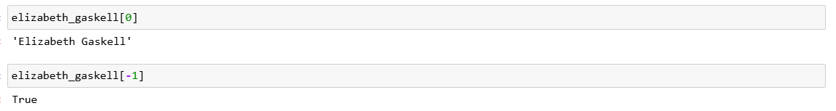
5. Python Basics. Data Structures. Tuples()
Tuples are an immutable sequence data type.
Tuples are declared using () instead of [].
Initialization of a tuple (a tuple can contain different data types!)
Accessing elements

Slide 24
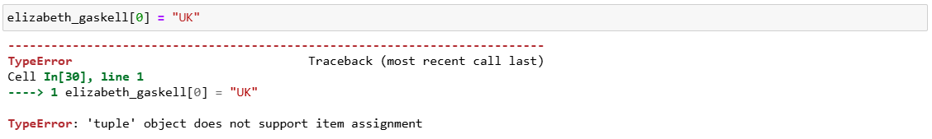
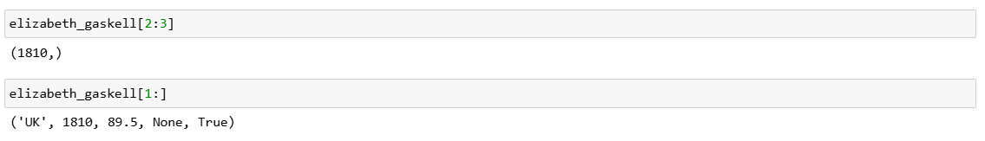
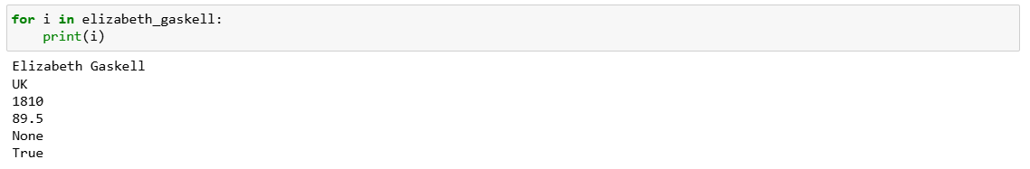
We can´t change the elements of a tuple: it is an unmutable data structure.
Slicing.
Iteration.

Slide 25
Check if a value exists in a tuple.

Slide 26
5. Python Basics: Data Structures. Dictionaries {}
Key-Value pair.
Dictionaries are very similar to lists (are mutable) but have a key and value for each entry.
Dictionaries are created using {}
Initialization

Slide 27
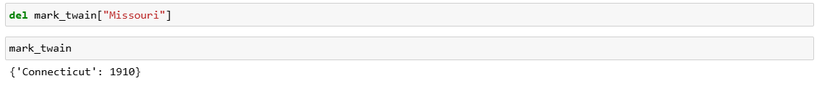
Accessing values: (Note: We access a value by its corresponding key).
Changing values: (Note: A Python dictionary is a mutable data structure).
Removing elements.
Check if an entry exists for a specific key.
For extra information (“Cheat Sheet”) about dictionaries have a look at: Exercises/Day 2/Extra information on Dictionaries.ipynb · main · ZI IT Training / APPB / APPB7-FS24 · GitLab

Slide 28
5. Python Basics. Methods (list methods)
Python: Object Oriented Programming.
An important characteristic of the Python language is the consistency of its object model. Every number, string, data structure, function, class, module, and so on exists in the Python interpreter in its own “box,” which is referred to as a Python object. Each object has an associated type (e.g., integer, string, or function) and internal data. In practice this makes the language very flexible, as even functions can be treated like any other object.
Reference: https://wesmckinney.com/book/python-basics.html#semantics_everything_object

Slide 29
What is a method?
Almost every object in Python has attached functions, known as methods, that have access to the object’s internal contents. Some examples include:
String methods: split(), strip(), join(), index(), find()
List methods: index(), append(), insert(), remove(), sort()

Slide 30
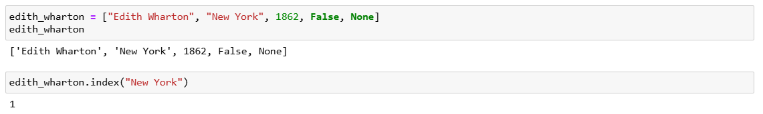
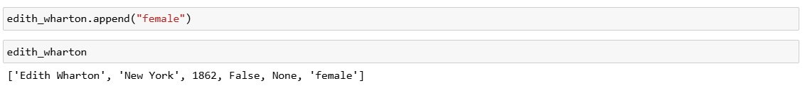
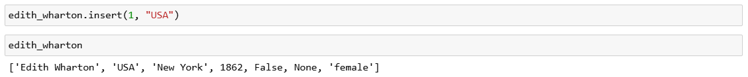
Index()
Append(). It adds the argument to the end of the list.
Insert(). It requires two arguments: the first argument is the index for the new value, and the second argument is the new value to be inserted.

Slide 31
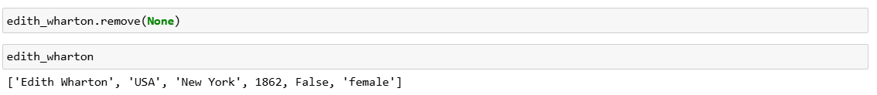
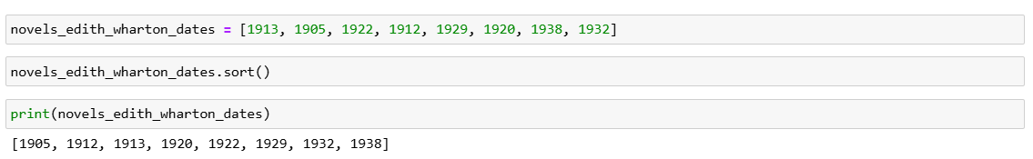
Remove()
Sort(). This method only Works on lists that only have integers or floats.

Slide 32
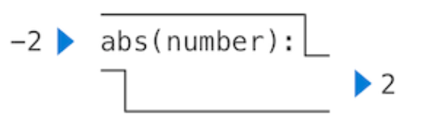
5. Python Basics. Functions
Functions have some input (their arguments) and return some output (the result of applying them). Built-in functions can be depicted as a small machine that takes input and produces output.
For example: abs(-2)
2
Reference: “Composing Programs” (http://composingprograms.com/)

Slide 33
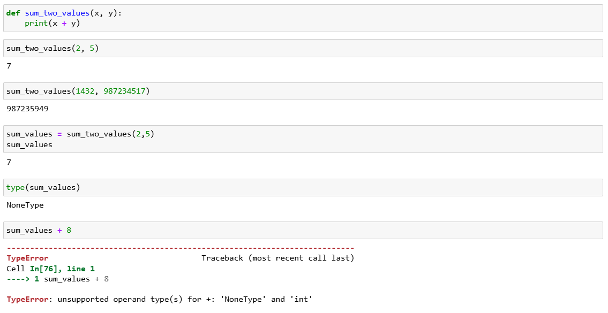
User Defined Functions. Print and Return
Print Functions

Slide 34
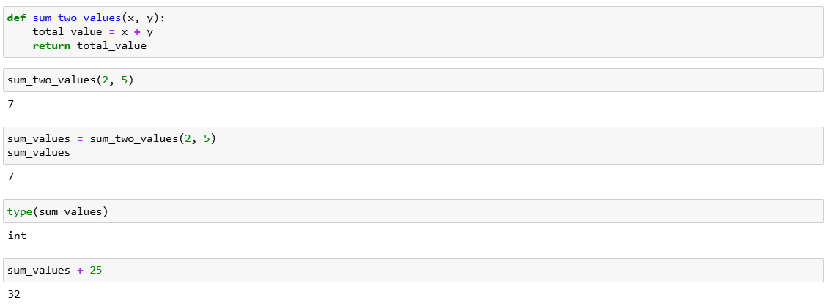
Return Functions

Slide 35
Wrapping up the day
Let’s do together Activity 2!

Slide 36
Day 2. Numpy
1. What are Python Libraries?
2. Numpy: Learning Data Analytics with Digital Humanities Metadata!
3. Numpy Arrays: Introduction
4. Numpy Data Types
5. Numpy Data Conversion
6. Numpy Arrays: dimensionality.
7. Numpy Array Methods (or Attributes).
8. Numpy Array Slicing
9. Numpy Array Concatenation and Splitting
10. Univesal Functions
11. Aggregations
12. The Boolean Data Type and Comparison Operators
13. Reading and writing data with Numpy

Slide 37
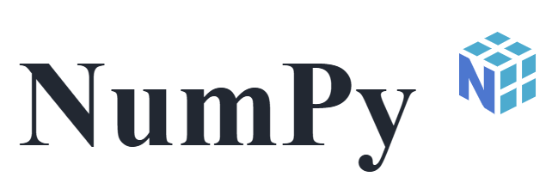





1. What is a Python Library?
A Python library is a collection of modules or files that contain pre-written code, including functions, classes, and methods, which help programmers perform specific tasks efficiently without rewriting existing code.

Slide 38
Numerical Python.
Very important!
Other Machine Learning Libraries (ScikitLearn, TensorFlow) use NumPy arrays as inputs.

Slide 39
2. Numpy Arrays
“Numpy Array” just means “list”.
Unlike normal Python lists, numpy arrays can only contain one data type. This makes them more efficient as it is not necessary to check the data types inside the list.
But, they can be any data type (string, integers, floats…).
If we write numpy arrays with different data types, we won´t get an error message. But it will be less efficient.

Slide 40
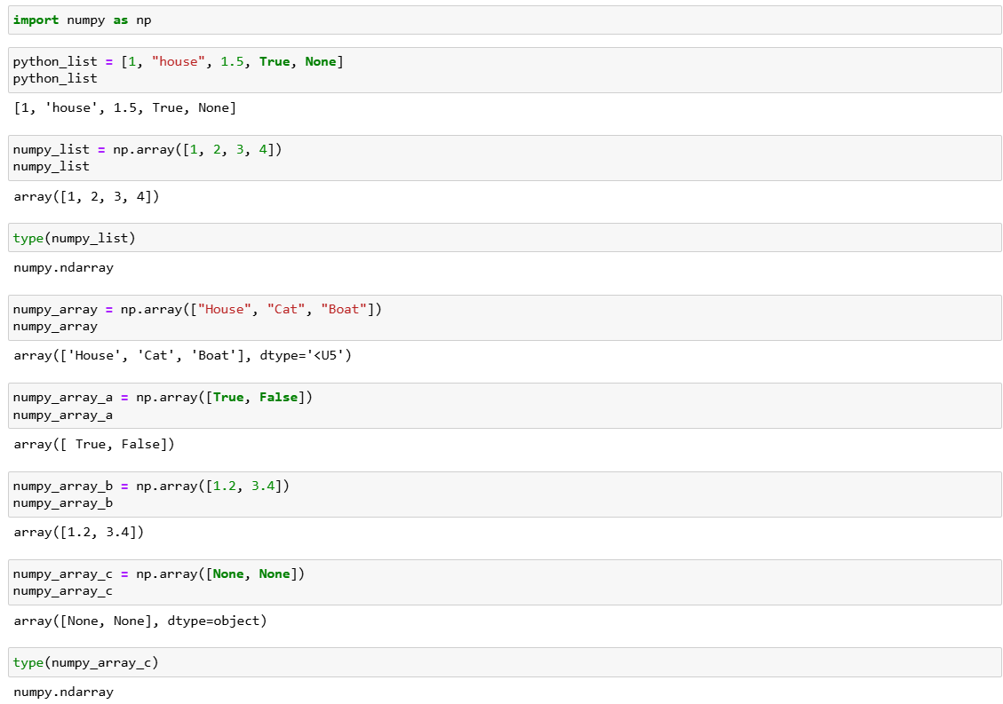

Slide 41
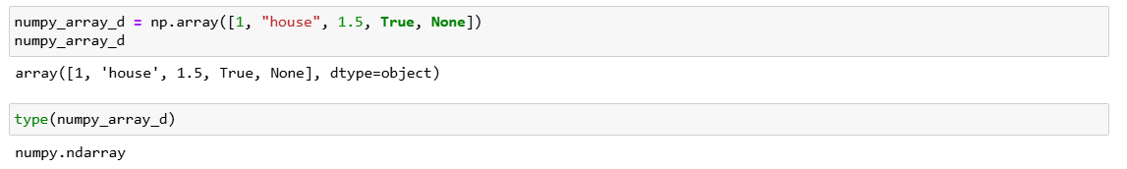
What happens if we create an array with different data types? It will be ok.
NumPy sets the array's data type (dtype) to object. This means each element is stored as a generic Python object, allowing different data types within the same array.​
Unlike standard homogeneous arrays where all elements share the same type (e.g., all integers or all strings), the object dtype array can hold various types because each element is actually a pointer/reference to a Python object in memory rather than a fixed-size typed block of memory.
This flexibility comes at a cost: performance is slower compared to homogeneous NumPy arrays because operations are no longer done with optimized C-based routines.

Slide 42
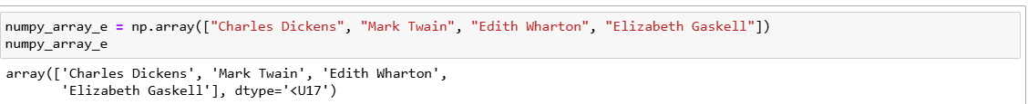
3. Numpy Data Types
Numpy is more precise than pandas or regular Python lists. It includes information about bites.
That U17 in there means “Unicode string” and that 17 means “up to 17 characters” (meaning that that is the largest string in our array). Numpy does this to indicate that the largest memory unit needed is 17.
Unicode string refers to: Unicode (a universal character encoding standard).

Slide 43
Numpy Data Types
However, integers do not include that same information.
Why? Because Numpy Integers have fixed, standard sizes (e.g., 32-bit or 64-bit) depending on our system architecture and the specific integer type used.
The dtype int corresponds to a fixed-size integer type like int32 or int64, so no additional length specification is needed in the dtype display. The integer is always stored as a single fixed-size block of memory, with no variability like strings.
We can always check the type of data we have in our array using .dtype

Slide 44
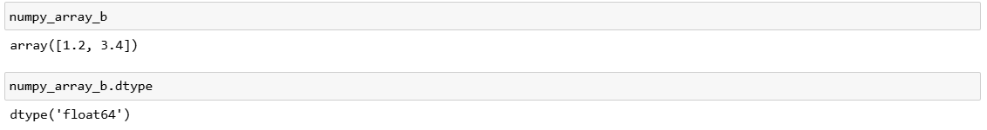
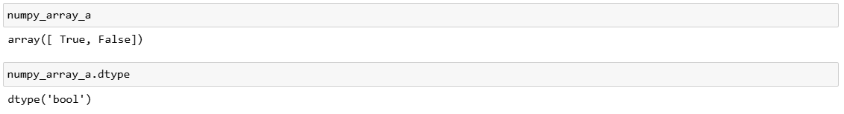
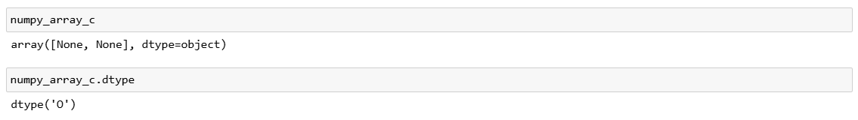
What happens with other data types of numpy arrays?
Floats
Boolean
Non-Type (None)

Slide 45
And what happens when we create a numpy array with different data types?
Numpy decides to call this data type “Object”.
As mentioned, if we do this, we lose most of the performance and vectorized operations advantages that make NumPy arrays fast—those only apply to homogeneous, fixed-type arrays. But we won´t get any error messages.

Slide 46
Numpy Data Types: Summary
Data Type | Numpy Representation
String | Unicode. Numpy uses U-[Length] to indicate largest size in the numpy array
Integer | Int32, Int64
Float | Float32, Float64
Boolean | Bool
None | Object
Mixed data type array | Object

Slide 47
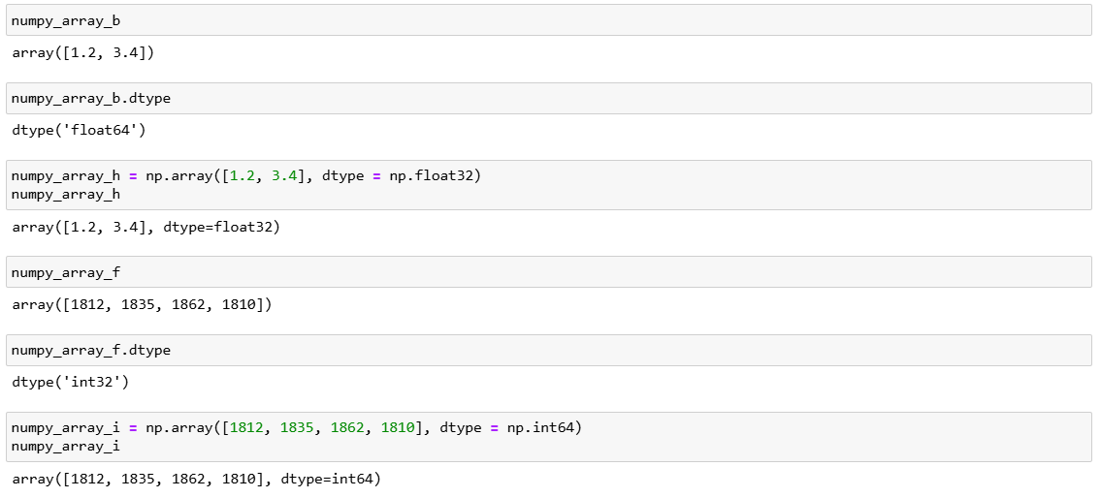
Extra hint
We can decide what type of data we want inside our numpy array.

Slide 48
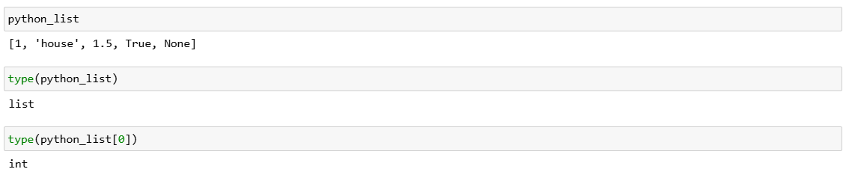
Differences between Python Lists and Numpy Arrays in terms of data types
In Python lists we can check the type of data structure (i.e. list) but we have to check the data type of each element in that list.

Slide 49
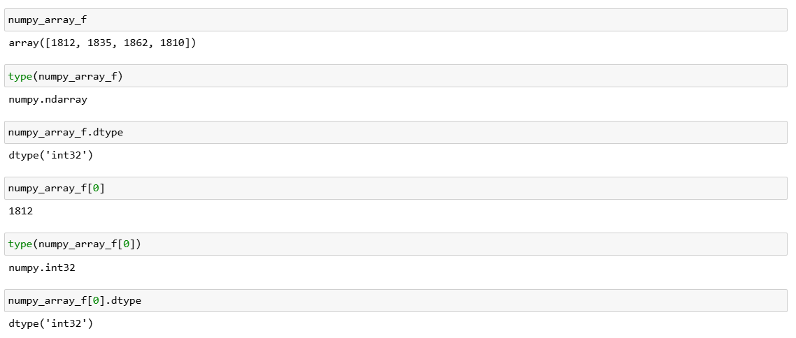
Differences between Python Lists and Numpy Arrays in terms of data types
With Numpy arrays we don´t need to do that. We can check the type of data structure, but as explained, all the data types inside are the same type. So we don´t have to check the individual data types.

Slide 50
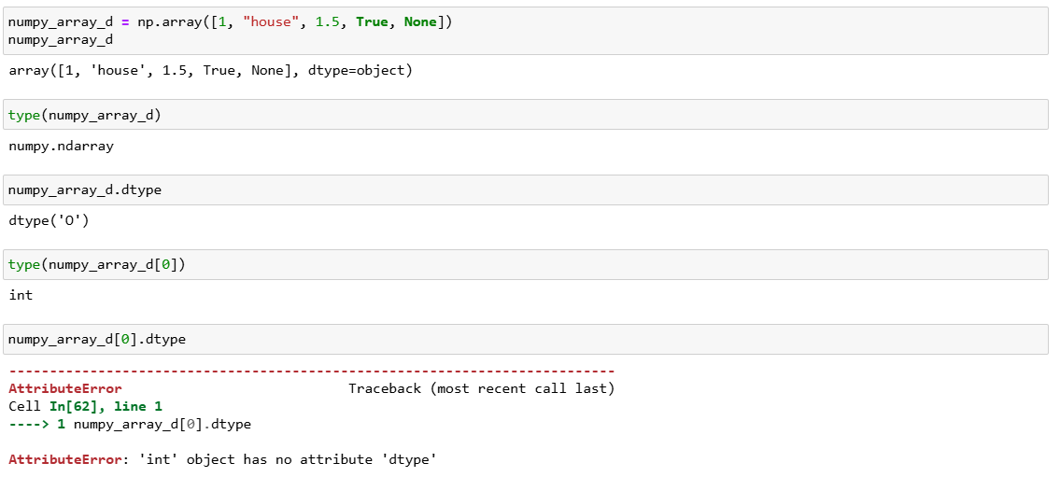
And what happens when we try to get the data types of a heterogeneous data type list?
In a homogeneous NumPy array (like integers), each element is a NumPy scalar, which has a .dtype attribute. So array[0] is a NumPy integer type (e.g., np.int32 or np.int64), and array[0].dtype works.​
In a mixed-type array (dtype=object, like array_b, which contains ints, strings, floats, etc.), each element is a regular Python object, not a NumPy scalar. Python objects (like int, str, None, etc.) do not have a .dtype attribute. For example, the integer 1 in standard Python is just an int object and has no .dtype property

Slide 51
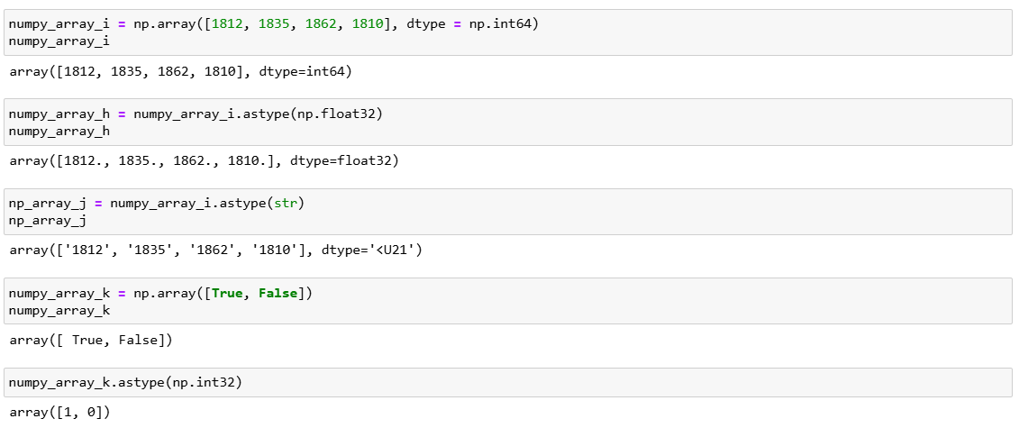
Numpy Data Conversion
We can convert numpy arrays to different types of data using .astype()
Day 2 Activity 1

Slide 52
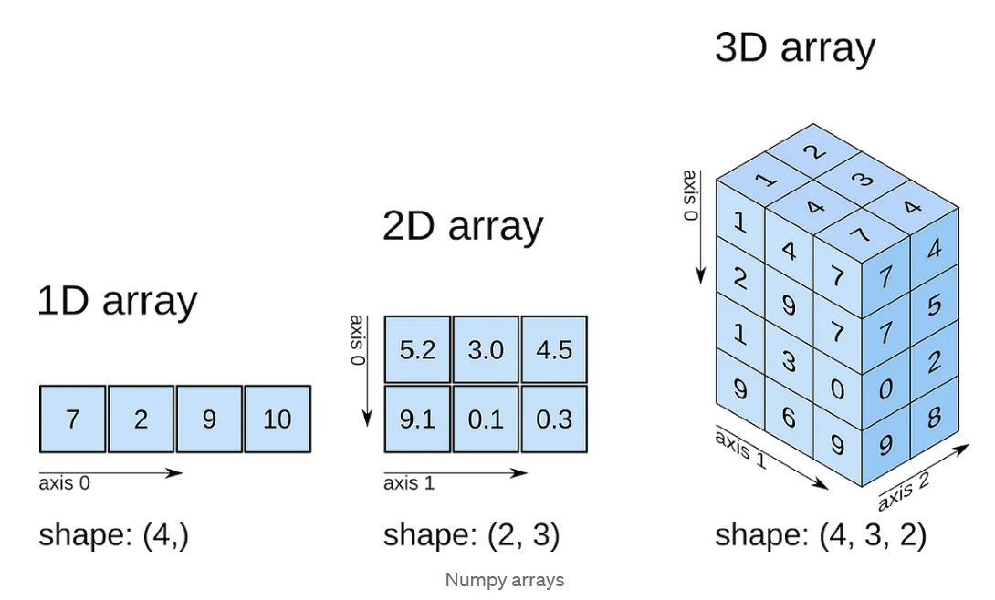
6. Numpy Arrays: Dimensionality
We can have 1-dimensional array (i.e. just one row, one dimension). This is called a vector.
We can have a 2-dimensional array (i.e. two dimensions). This is called a matrix.
We can have a 3-dimensional array (i.e. three dimensions). This is called a tensor.
We can have tons of dimensions arrays (mathematical terms).
In this course we are mainly going to work with 2-dimensional arrays (2-n).
Source: Data Science Practical No. 3.1 Write a NumPy program to count the number of dimensions, the number of elements, and the number of bytes for each element in a given array. | by Pradnya Kumavat | Medium

Slide 53
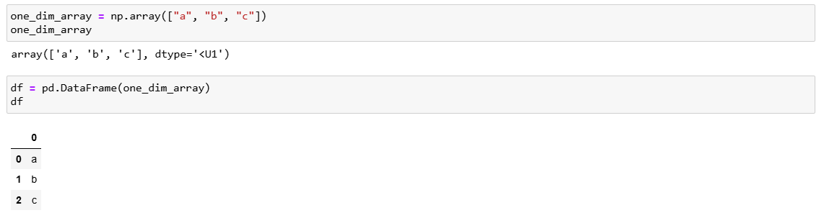
6. Numpy Arrays. Dimensionality
Let’s create a 1-n numpy array (also known as vector).
So, numpy arrays have rows and colums.
One dimensional arrays can be either vertical or horizontal.
a
b
c
a | b | c

Slide 54
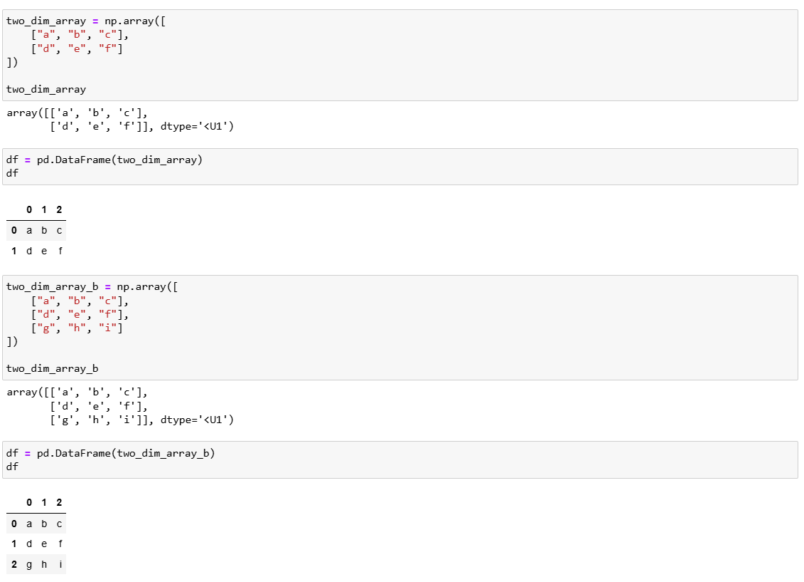
And now let’s create a 2-n array (also known as matrix).
Columns
a | b | c
d | e | f
g | h | i
Rows

Slide 55
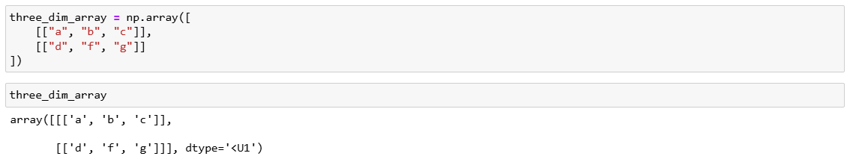
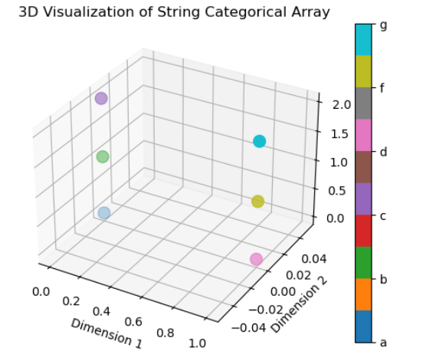
Finally, and just to understand how things work, let’s create a 3-d numpy array (also known as tensor).

Slide 56
7. Numpy Array Methods/Attributes
Numpy has a variety of methods (or attributes) that are very handy:
.ndim
.shape
.size
.arange()
.reshape()

Slide 57

.ndim (Number of dimensions)

Slide 58

.shape. Tuple containing the size of each dimension.

Slide 59

.size. The total size of the array (number of elements)

Slide 60


.arange(). Similar to the Python list range method.
.reshape(). We can change the distribution of an array

Slide 61
8. Numpy Array Slicing
One dimensional array
Slice | Description
x[:5] | First five elements
x[5:] | All elements after index 5
x[4:7] | Middle subarray
x[::2] | Every other element
x[1::2] | Every other element, starting at index 1
x[::-1] | All elements, reversed
x[5::-1] | Reverses all elements up until index 5 (included)

Slide 62


Slide 63

Two dimensional arrays

Slide 64


Slide 65



Slide 66


We can change the content of arrays as well.
We over-write the variable!

Slide 67

9. Array Concatenation and Splitting
We can concatenate (or join two or more arrays) by using the function np.concatenate

Slide 68


And we can split an array by using the function np.split(). This Will divide our array into as many lists as we want (so, we won´t have a numpy array anymore, but a Python list).
And we can remove a row using the np.delete() function.
Day 2 Activity 2

Slide 69

10. Universal Functions
We can use for loops to do mathematical operations on Python lists. For example: if we would like to add the values of one Python list [1, 2, 3, 4] to a second Python list [4, 5, 6, 7] to have a third Python list that is a combination of both [5, 7, 9, 11], we can use a for loop:

Slide 70

Numpy however offers a much faster and more convenient alternative: universal functions.
Let’s see other examples.
np.substract()

Slide 71


np.multiply
np.divide

Slide 72


Slide 73


In Numpy we can also use an alternative way of storing values. So, instead of using [list].append(values), like in Python:
We can do things faster:
Day 2 Activity 3

Slide 74

11. Aggregations
Aggregations are a type of Numpy Methods that allow us to compute very quickly statistics. For example, if we have an unorganized list of the years in which Dickens wrote his books, we can use np.max and np.min to find very quickly which year corresponds to the earliest and latest publications of his books.

Slide 75

Aggregations

Slide 76
np.sum
np.mean
np.std
np.median

Slide 77


np.argmax()
np.argmin()

Slide 78
12. The Boolean Data Type and Comparison Operators
Boolean data type: True, False (only two possible values)
– Comparison operators compare two values and evaluate to a single Boolean value
– The comparison operators are ==, !=, <, >, <=, and >=
– Boolean operators are used to compare Boolean values
– The Boolean operators are or, and, and not
– We can mix Boolean and comparison operators to create conditions

Slide 79

Comparison Operators as Ufunc

Slide 80


np.equal
np.not_equal

Slide 81



np.less
np.less_equal
np.greater

Slide 82


Np.greater_equal
Comparing arrays

Slide 83

The np.count_nonzero() function will count the number of True entries in a Boolean array:

Slide 84

13. Reading and writing data with Numpy. A) CSV Files
CSV (Comma Separated Values) are the most common form of files in the Data Science world. While Pandas is usually the library of choice for dealing with CSV, we can also use Numpy to open CSV files.
Each line in a CSV file represents a row in the spreadsheet, and commas separate the cells in the row:

Slide 85





Slide 86



Slide 87
Reading and writing data. B) Numpy Data
Let’s imagine that we do some operations with numpy. For example: let’s try to find out what is the mean year of Charles Dickens literary production and let’s find out how many books he wrote before and after that. Then let’s save each value into a new variable with a numpy array containing both numbers.

Slide 88


Slide 89

Now we can save that into a txt file using np.savetxt()
And we can re-open that file (or any other file) with np.loadtxt()

Slide 90
Let’s wrap up the day doing one final coding activity! ☺
Day 2 Activity 4

Slide 91
Day 3. Pandas
1. Pandas. THE Data Science library
2. Pandas CSV Dataframes and Pandas Series
3. Creating Pandas CSV Dataframes
4. Slicing Pandas Series
5. Slicing Pandas Dataframes. Loc and Iloc.
6. Missing values. NaN
7. Reading and Writing Files in Pandas.
7.1. Paths
7.2. Bash
7.3. Reading Files with Pandas
7.4. Some Interesting Data Sources
8. Aggregating and Grouping Data in Pandas.
8.1. Numpy vs. Pandas Aggregation
8.2. Split, Apply, Combine. The groupby() function
8.3. Aggregate and Apply
9. Merging dataframes. Concat and Merge

Slide 92

1. Pandas: THE Data Science Library
Pandas is one of the most Python Libraries out there.
It is particularly useful to create, manipulate, and store CSV (Comma Separated Value) Dataframes. Therefore, it is an ideal library to work with tabular data.
The name Pandas comes from the economics term Panel Data (multidimensional data involving measurements over time).
Check out this website for an excellent Pandas tutorial offered by Pandas themselves: 10 minutes to pandas — pandas 2.3.3 documentation

Slide 93


2. Pandas CSV Dataframes
Pandas, as mentioned, is a great library for reading (AKA opening), manipulating, creating, and writing (AKA saving) tabular data.
The most used format of tabular data (AKA “table”) is something called CSV, that stands for “Comma Separated Value”.
CSV dataframes are the same complex as 2-n Numpy Arrays: Matrixes. They consist of rows and columns, and they have x-y coordinates.

Slide 94

2. Pandas Series
Each Pandas Dataframe consists of columns and rows. We mentioned that Numpy Arrays (or Matrixes) tend to display data horizontally (so, focusing on rows) and Pandas DataFrames tend to display data vertically (so, focusing on columns). This is “Day 2. Activity 2” (we saw this together in class last week!):

Slide 95

2. Pandas Series
If we select a column in a dataframe, we will get a Pandas Series, the Pandas Numpy Array equivalent.
Python lists == np.arrays == pandas series. Data Structures = n-1 (x)
Csv dataframe == matrix (n-2 np.array) == table

Slide 96

2. Pandas Series
A Pandas Series is a one-dimensional array of indexed data.
The main difference with numpy arrays is that Pandas Series are indexed. That means that even if it is just one-dimension (the index does not count as a columna, so it is 1-n, not a 2-n matrix), we are going to see the index when we check our variable.
index
Data type

Slide 97

2. Pandas Series
We can explicity indicate an index if we would like that.

Slide 98

2. Pandas Series
And we can also check the index using the pandas attribute index.

Slide 99

2. Pandas Series
And that is why we can build a Pandas Series from a dictionary. The keys will now become indexes, and the values will become the main values.

Slide 100

2. Pandas Series
But, we can loop over a Pandas Series just as we do with a list.

Slide 101
2. Pandas CSV Dataframes and Pandas Series
A Pandas CSV Dataframe (i.e. a 2 dim matrix) is just many Pandas Series (i.e. a 1 dim vector or array) + the name of a column piled together.

Slide 102

3. Creating Pandas CSV Dataframes
There are many different ways of building a dataframe. We are going to learn three:
First one: Using a dictionary. This can be done in two different ways. A) Using a Dictionary wrapped by a list.

Slide 103

B) Creating manually a dictionary, but making sure that the series values (remember the structure “col1”: series) are either a list or a pandas series.

Slide 104

Second one. Using a Pandas Series (or a list) + the name of a column.

Slide 105

If we would like to have one column per autor name it is a little bit more complicated!

Slide 106

Third one. We first create a column, and then we manually add more.

Slide 107


4. Slicing Pandas Series
Pandas Series is somewhere between a list and a dictionary.
List:
We can select Series with Brackets just as we do with lists. But we can´t use the [-1]!
We can change the values of specific ítems just as we do with lists.

Slide 108
Dictionaries
But, we can use the keys() dictionary method to check the index of the Pandas Series

Slide 109

5. Slicing Pandas Dataframes
A Pandas Dataframe is an x,y Matrix that contains Rows and Columns. We can select both!
5.1. Slicing Columns. We can slice columns in two different ways:
Using the Column Name

Slide 110

And we can also select more tan one column name.

Slide 111


Loc and Iloc. Slice both columns and rows
It is very similar to the numpy matrix slicing [rows : colums]. So, [0:4, 0:3] means that we are selecting rows 0-4, and columns 0-3.

Slide 112


Iloc. Integer-location
Iloc uses integers to indicate how we slice things. We use a bracket [rows:columns], and inside the numbers that we want to select.
If we only want to select the values of the first row, we will use [0, :]
If we only want to select the values of the first column, we Will use [:, 0]

Slide 113

If we want to select the first four rows and columns 2-3, we will use [0:4, 1:3]

Slide 114

Loc. Location (text labels for columns)
Loc uses integers for slicing rows, but labels (the Title of the column) for slicing columns.
It also uses the bracket notation [row:column], but now it looks like [0:3, “Name of Column”]
Day 3 Activity 1

Slide 115


6. Missing Values: NaN
It is very common that CSV dataframes have some missing values. When this happens, the Non-type (NaN) is found. We can use the method dropna(), and it will drop the rows that contain missing values.

Slide 116
7. Reading and Writing Files in Pandas
7.1. Paths
To be able to open a file in Jupyter Notebooks, first we need to find where that file is. In Computer science, that is called a Path. Paths are computer-user specific, as they indicate where each of us have files in our own laptop. For example: this is mine.

Slide 117


7.2. Bash
Before mouses existed, computer users had to use something called “Text-based command-line interfaces (CLI)”. That means that, if we would be using a computer in 1960-1980, we would need to be writing all the time commands like “computer go to this file”, or “computer close this folder”.
Bash (that stands for Bourne Again Shell),is a command-line interpreter and scripting language. It is the default Shell on most Linux, macOS (pre-Catalina) and Unix-Like systems.
It acts as a bridge between us and the operating system. It allows us to run commands, navigate files (cd, ls, pwd), manage processes, and automate tasks via scripts.
It is how we can tell Jupyter Notebooks that we want to move around inside our file system for the purposes of dealing with paths.

Slide 118

7.2. Bash
The main Bash commands are:
pwd. It stands for print working directory.
ls. It stands for list. It allows us to see all the folders in our directory.

Slide 119
mkdir. It stands for “make directory”. It creates a folder in our laptops/Jupyter Notebooks interface.
cd. It stands for “change directory”.
cd .. If we want to change directories one level up, we use cd ..
cd .. relative path. And if we want to change directories one level down, we can write a relative path (that means, shorter path than the whole path).
cd .. absolute path. If we want to change directories to a file that is not one step inmediately below or above, we then need to write an absolute path (that means, the whole path).
cd ~ If we want to go to our root directory, we use cd ~ (press “alt-great” on the number 4 key!).

Slide 120


7.3. Reading Files with Pandas
Pandas provides de pd.read_csv(“file.csv”) function to read CSV dataframes. We need to specify the argument index_col = 0 if we want a nice visualization without an extra column index.
Without index_col = 0

Slide 121

7.3. Reading Files with Pandas
Inside pd.read_csv() we can also write the name of a path. It is very frequent that our files will be in a folder inside our Jupyter Notebooks directory. To be able to access that, we will need to write a path.
Day 3 Activity 2

Slide 122


7.3. Writing Files with Pandas
To save our DataFrame into a csv file that we can access in our computer, we can use the function pd.to_csv(“name of file.csv”) function. If you remember, some slides ago we had a csv dataframe with NaN values than then we dropped using the .dropna() method.

Slide 123
7.3. Writing Files with Pandas
If we would like to save that file in our computer, we can use the pd.to_csv(“name of file.csv”) function.

Slide 124
7.4. Some Interesting Data Sources
If you would like to find some data (other tan this very cool Digital Humanities dataset ;)) in a csv dataframe format to practice your Pandas Skills, check out these sources!
Federal Statistical Office: Stat - Swiss Stats Explorer | Federal Statistical Office – FSO
OpenData: https://opendata.swiss/en/
OpenData Zurich: https://www.stadt-zuerich.ch/opendata.secure.html
United Nations: http://data.un.org/
World Health Organization: http://apps.who.int/gho/data/node.home
World Bank: https://data.worldbank.org/
Kaggle: https://www.kaggle.com/datasets
Cern: http://opendata.cern.ch/
Nasa: https://data.nasa.gov/
FiveThirtyEight: https://github.com/fivethirtyeight/data

Slide 125
8. Aggregating and Grouping Data in Pandas
8.1. Numpy vs. Pandas Aggretation
If we go back some slides ago, we discussed how numpy provided very convenient functions for data aggretation.

Slide 126


The pandas .describe() method conveniently provides all those data analytics for us in a dataframe.

Slide 127

And if we want to select those values, we can transform the index column into a proper column, and then use loc/iloc to select that.

Slide 128

We can use the numpy data aggregation methods on Pandas series if we only want to do certain data analytics.

Slide 129

8.2. Split, Apply, Combine: The groupby() function
Sometimes, we will have several repeated values in our dataframe.
We may need to do some analytics on those values.
The groupby() function will help us with that.

Slide 130

Source: David Pinezich slides and Python Data Science Handbook

Slide 131

We can also use .groupby() with two columns, but we have to be careful with the syntax.

Slide 132

8.3. Aggregate and Apply
.agg (aggregate) allows us to combine several aggregation functions at the same time

Slide 133

Apply. Apply allow us to map a function to a whole dataframe. Its main advantage is that we can custom-made that function.

Slide 134


9. Merging dataframes. Concat and Merge
Let’s imagine that we have two different dataframes and we want to join them by the column.

Slide 135

Merge. We can use merge if both dataframes share a column (in this case “Titles”) with the same name.

Slide 136

Concat. And, if both dataframes do not share a same named-column (or if we don´t want to drop that column), we can use concat.

Slide 137
Let’s wrap up the day with a final activity!
Day 3 Activity 3

Slide 138

Appendix: Working with Files in Python
The Open() Function
The CSV library

Slide 139

1. Opening files with the Open() Function
There are more ways of reading files than the Pandas pd.read_csv(filename.csv) function. It all depends on the type of data that we want to open.
If we have txt files, we can use the open Python Open() function that has a slightly peculiar syntax:

Slide 140

And we can also use the Open() function with a path.

Slide 141
1. Opening files with the Open() Function
The mode defines how the content of the file should be treated
• ’r’: read only
• ’w’: write only
• ’r+’: read and write
• ’a’: append

Slide 142

2. The CSV library
We can also use the csv library to open csv files. But it is les practical than the Pandas function.

Slide 143

And we can also use the CSV Library to export (or write) csv files.

Slide 144
Let’s wrap up things doing an activity!
Appendix
Activity 1

Slide 145
Day 4. Seaborn
1. Seaborn: visualizing things.
2. Seaborn Syntac: Introduction.
3. Seaborn Pairplots
4. Seaborn Datasets
5. Seaborn Syntax II
6. Styling Themes
6.1. The Setstyle option
7. Colours

Slide 146

1. Seaborn. Visualizing Things.
Seaborn is a Python data visualization library based on matplotlib. It provides a high-level interface for drawing attractive and informative statistical graphics. It is also a great complement to Pandas.

Slide 147

Let’s do one initial example.

Slide 148

So we got a plot that combines a bar and a scatter plot.

Slide 149
2. Seaborn Syntax: Introduction
To be able to do visualizations with Seaborn, we need to have the sns.jointplot() function. Inside we need to indicate:
X. The data (DataFrame Column) that we want to include in the x axes of the plot.
Y. The data (DataFrame Column) that we want to include in the y axes of the plot.
Dataframe. The variable where the dataframe that we want to use is stored.
Kind. There are 6 types of plots: “scatter” | “kde” | “hist” | “hex” | “reg” | “resid”
On top of that, there are also other arguments that we can include. We will use size arguments to control the size of the figure. To adapt the y axes to the size we want, we use height , and to adapt the x axes to the size we want, we use space.

Slide 150

KDE
In Seaborn, KDE (Kernel Density Estimate) creates smooth, continuous curves to visualize the probability density of a dataset, effectively showing how data points are distributed without using bars like a histogram, helping identify underlying patterns and trends. It's a non-parametric way to estimate the probability density function (PDF) of a continuous variable, smoothing out data points using a kernel (like a Gaussian) to form a curve or contours.

Slide 151

Histogram
A histogram is a bar plot where the axis representing the data variable is divided into a set of discrete bins and the count of observations falling within each bin is shown using the height of the corresponding bar.

Slide 152

HEX
In Seaborn, "hex" (or kind="hex") typically refers to a Hexbin plot, a specialized scatter plot that bins data into hexagonal cells to visualize density, with darker colors indicating more data points, great for overplotted data.

Slide 153

REG
Reg refers to regression plots, primarily created by the seaborn.regplot() function, which visualizes the linear relationship between two variables by overlaying a scatter plot of data points with a fitted regression line and its confidence interval, helping to understand trends and correlations. It's a powerful tool for exploring relationships in data, often used with lmplot, jointplot, or pairplot by setting kind='reg’.

Slide 154

RESID
This method is used to plot the residuals of linear regression. This method will regress y on x and then draw a scatter plot of the residuals.

Slide 155

Question for you. Can you name the plot?

Slide 156
3. Seaborn Pair-Plots
Seaborn provides the pairplot() method, which is used for visualizing relationships between multiple variables in a dataset. By creating a grid of scatter plots it helps to identify how different features interact with each other to identify patterns, correlations and trends in data.
Let’s look at an example together!

Slide 157



Slide 158
Row 1 is “Year”: every panel in this row has Year on the vertical axis and another variable on the horizontal axis (Year vs Year, Total Words vs Year, Unique Words vs Year).​
Row 2 is “Total Words”: these panels have Total Words on the vertical axis and the column variable on the horizontal axis (Year vs Total Words, Total Words vs Total Words, Unique Words vs Total Words).​
Row 3 is “Unique Words”: these panels have Unique Words on the vertical axis and the column variable on the horizontal axis.
We can see one pattern: Total words and unique words. It looks like the longer a book is (higher amount of total words) the higher it is the number of unique words. There is no clear correlation between year and book length or year and unique amount of total words.

Slide 159

4. Seaborn Datasets
Seaborn incorporates 17 datasets that are very useful for practicing our data science skills. The sns.get_dataset_names() provides an index of all of them.

Slide 160


Loading Datasets
Loading datasets is really easy with the sns.load_dataset(“dataset”) option. Let’s have a look at the Titanic Dataset.

Slide 161


If we compare fare with survivors, we can see that there is a tendency that the more people paid for their tickets the more they managed to stay alive when the boat sank. We can combine two types of visualizations (stripplot and boxplot) to better understand patterns.

Slide 162


Another example is the tips dataset. It provides information on how customers tip according to gender, day, time, snoking, and plate size.

Slide 163


And we can use a violinplot or a pointplot to check whether men or women tip higher (according to the data). Apparently males tip more!

Slide 164

And finally another example is the car crashes dataset.

Slide 165


We can use the swarmplot and the bar plot for comparison purposes to see if there is any correlation between the total column (that gives the total number of automobile collisions per billion miles for each U.S. state) and the alcohol column. And we do see a very clear correlation.

Slide 166
5. Seaborb Syntax II
So, we can use two types of syntax with seaborn.
sns.jointplot(x = “column", y = “column", data = variable, height = 7, space=0.15, kind = “plottype“)
sns.stripplot(x="diet", y="pulse", data=exercise)
sns.swarmplot(x="diet", y="pulse", data=exercise)
sns.boxplot(x="diet", y="pulse", data=exercise)
sns.violinplot(x="diet", y="pulse", data=exercise)
sns.barplot(x="diet", y="pulse", data=exercise)
sns.pointplot(x="diet", y="pulse", data=exercise)

Slide 167


6. Styling and Themes
6.1. The Setstyle option
The Matplotlib library is already highly customizable but a bit dull when it comes to styling options
It can be very hard to style a matplotlib-visualization to your needs
Here comes Seaborn very handy with its customized themes and a high-level interface for customizing and controlling the look of Matplotlib figures

Slide 168
6.1. The Set Style Option
Seaborn supports various themes that can make styling the plots really easy and save a lot of time. Using the set_style() function of Seaborn we can set any of the themes available on Seaborn library. Here are a few of the popular themes:
Darkgrid, Whitegrid, Dark, White

Slide 169




Slide 170

7. Colours
7.1. The colour palette at Seaborn
Let us also have a look at the various color palettes seaborn offers (only a small extract):

Slide 171

We can use the Hue argument to indicate which column we want to colour.
We can also use sns.set_palette() to indicate the colour palette we want.
By default, this is the colour palette.

Slide 172




Slide 173

AND WE ARE FINISHED! Thanks so much for your attention ☺

Slide 174
Works Cited
Pinezich, David. “Python: Data Essentials”. UZH. (ZI IT Training / APPD / appd_dp_hs22 · GitLab).

